Slide 1
The concept of rationality, the nature of environments

Slide 2
Agents in Artificial Intelligence
An AI system can be defined as the study of the rational agent and its environment.
The agents sense the environment through sensors and act on their environment through actuators.
An AI agent can have mental properties such as knowledge, belief, intention, etc.
What is an Agent?
An agent can be anything that perceiveits environment through sensors and act upon that environment through actuators.
An Agent runs in the cycle of perceiving, thinking, and acting.

Slide 3
An agent can be:
Human-Agent: A human agent has eyes, ears, and other organs which work for sensors and hand, legs, vocal tract work for actuators.
Robotic Agent: A robotic agent can have cameras, infrared range finder, NLP for sensors and various motors for actuators.
Software Agent: Software agent can have keystrokes, file contents as sensory input and act on those inputs and display output on the screen.
Hence the world around us is full of agents such as thermostat, cellphone, camera, and even we are also agents.

Slide 4
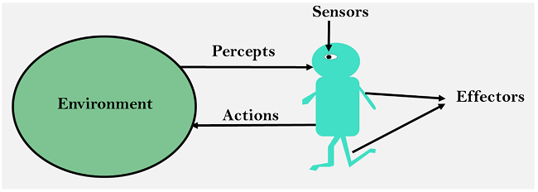
Sensor: Sensor is a device which detects the change in the environment and sends the information to other electronic devices. An agent observes its environment through sensors.
Actuators: Actuators are the component of machines that converts energy into motion. The actuators are only responsible for moving and controlling a system. An actuator can be an electric motor, gears, rails, etc.
Effectors: Effectors are the devices which affect the environment. Effectors can be legs, wheels, arms, fingers, wings, fins, and display screen.

Slide 5
Types of AI Agents
Agents can be grouped into five classes based on their degree of perceived intelligence and capability. All these agents can improve their performance and generate better action over the time. These are given below:
Simple Reflex Agent
Model-based reflex agent
Goal-based agents
Utility-based agent
Learning agent

Slide 6
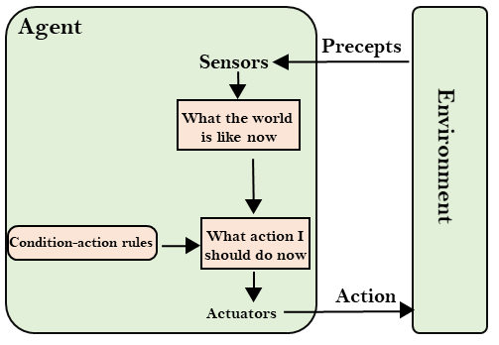
Simple Reflex agent:
The Simple reflex agents are the simplest agents. These agents take decisions on the basis of the current percepts and ignore the rest of the percept history.
These agents only succeed in the fully observable environment.
The Simple reflex agent does not consider any part of percepts history during their decision and action process.
The Simple reflex agent works on Condition-action rule, which means it maps the current state to action. Such as a Room Cleaner agent, it works only if there is dirt in the room.
Problems for the simple reflex agent design approach:
They have very limited intelligence
They do not have knowledge of non-perceptual parts of the current state
Mostly too big to generate and to store.
Not adaptive to changes in the environment.

Slide 7
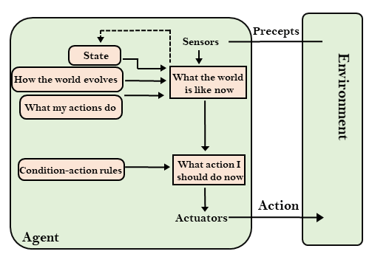
Model-based reflex agent
The Model-based agent can work in a partially observable environment, and track the situation.
A model-based agent has two important factors:
Model: It is knowledge about "how things happen in the world," so it is called a Model-based agent.
Internal State: It is a representation of the current state based on percept history.
These agents have the model, "which is knowledge of the world" and based on the model they perform actions.
Updating the agent state requires information about:
How the world evolves
How the agent's action affects the world.

Slide 8
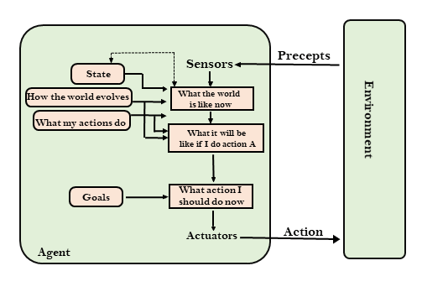
Goal-based agents
The knowledge of the current state environment is not always sufficient to decide for an agent to what to do.
The agent needs to know its goal which describes desirable situations.
Goal-based agents expand the capabilities of the model-based agent by having the "goal" information.
They choose an action, so that they can achieve the goal.
These agents may have to consider a long sequence of possible actions before deciding whether the goal is achieved or not.
Such considerations of different scenario are called searching and planning, which makes an agent proactive.

Slide 9
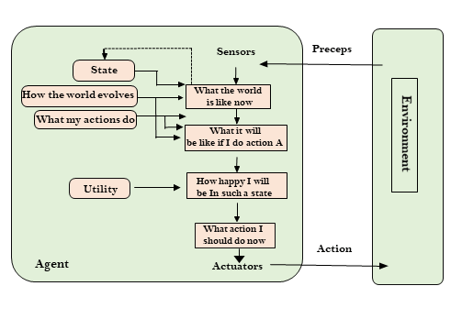
Utility-based agents
These agents are similar to the goal-based agent but provide an extra component of utility measurement which makes them different by providing a measure of success at a given state.
Utility-based agent act based not only goals but also the best way to achieve the goal.
The Utility-based agent is useful when there are multiple possible alternatives, and an agent has to choose in order to perform the best action.
The utility function maps each state to a real number to check how efficiently each action achieves the goals.

Slide 10
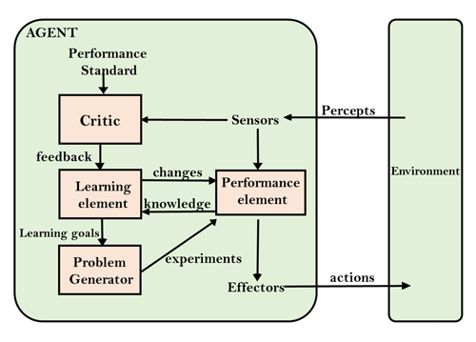
Learning Agents
A learning agent in AI is the type of agent which can learn from its past experiences, or it has learning capabilities.
It starts to act with basic knowledge and then able to act and adapt automatically through learning.
A learning agent has mainly four conceptual components, which are:
Learning element: It is responsible for making improvements by learning from environment
Critic: Learning element takes feedback from critic which describes that how well the agent is doing with respect to a fixed performance standard.
Performance element: It is responsible for selecting external action
Problem generator: This component is responsible for suggesting actions that will lead to new and informative experiences.
Hence, learning agents are able to learn, analyze performance, and look for new ways to improve the performance.

Slide 11
Search Algorithms
Problem-solving agents:
In Artificial Intelligence, Search techniques are universal problem-solving methods.
Rational agents or Problem-solving agents in AI mostly used these search strategies or algorithms to solve a specific problem and provide the best result.
Problem-solving agents are the goal-based agents and use atomic representation.
Search Algorithm Terminologies:
Search: Searching is a step by step procedure to solve a search-problem in a given search space. A search problem can have three main factors:
Search Space: Search space represents a set of possible solutions, which a system may have.
Start State: It is a state from where agent begins the search.
Goal test: It is a function which observe the current state and returns whether the goal state is achieved or not.

Slide 12
Search tree: A tree representation of search problem is called Search tree. The root of the search tree is the root node which is corresponding to the initial state.
Actions: It gives the description of all the available actions to the agent.
Transition model: A description of what each action do, can be represented as a transition model.
Path Cost: It is a function which assigns a numeric cost to each path.
Solution: It is an action sequence which leads from the start node to the goal node.
Optimal Solution: If a solution has the lowest cost among all solutions.

Slide 13
Properties of Search Algorithms:
Following are the four essential properties of search algorithms to compare the efficiency of these algorithms:
Completeness: A search algorithm is said to be complete if it guarantees to return a solution if at least any solution exists for any random input.
Optimality: If a solution found for an algorithm is guaranteed to be the best solution (lowest path cost) among all other solutions, then such a solution for is said to be an optimal solution.
Time Complexity: Time complexity is a measure of time for an algorithm to complete its task.
Space Complexity: It is the maximum storage space required at any point during the search, as the complexity of the problem.

Slide 14
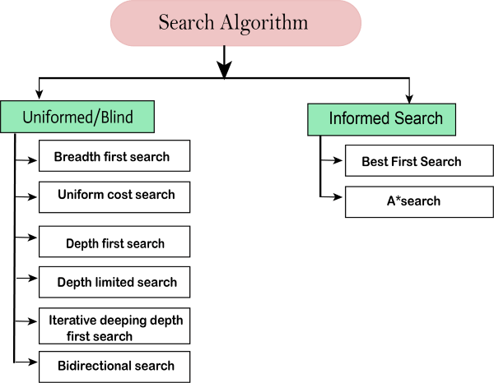
Types of search algorithms

Slide 15
Uninformed/Blind Search:
The uninformed search does not contain any domain knowledge such as closeness, the location of the goal.
It operates in a brute-force way as it only includes information about how to traverse the tree and how to identify leaf and goal nodes.
Uninformed search applies a way in which search tree is searched without any information about the search space like initial state operators and test for the goal, so it is also called blind search.
It examines each node of the tree until it achieves the goal node.
It can be divided into five main types:
Breadth-first search
Uniform cost search
Depth-first search
Iterative deepening depth-first search
Bidirectional Search

Slide 16
Informed Search
Informed search algorithms use domain knowledge.
In an informed search, problem information is available which can guide the search.
Informed search strategies can find a solution more efficiently than an uninformed search strategy.
Informed search is also called a Heuristic search.
A heuristic is a way which might not always be guaranteed for best solutions but guaranteed to find a good solution in reasonable time.
Informed search can solve much complex problem which could not be solved in another way.
An example of informed search algorithms is a traveling salesman problem.
Greedy Search
A* Search

Slide 17
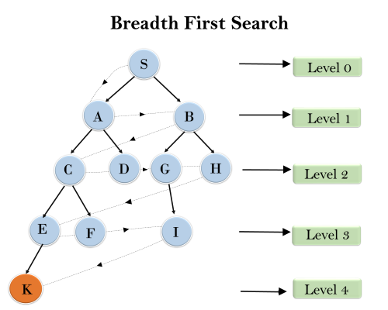
Breadth-first Search:
Breadth-first search is the most common search strategy for traversing a tree or graph.
This algorithm searches breadthwise in a tree or graph, so it is called breadth-first search.
BFS algorithm starts searching from the root node of the tree and expands all successor node at the current level before moving to nodes of next level.
The breadth-first search algorithm is an example of a general-graph search algorithm.
Breadth-first search implemented using FIFO queue data structure.
Example:
S---> A--->B---->C--->D---->G--->H--->E---->F---->I---->K

Slide 18
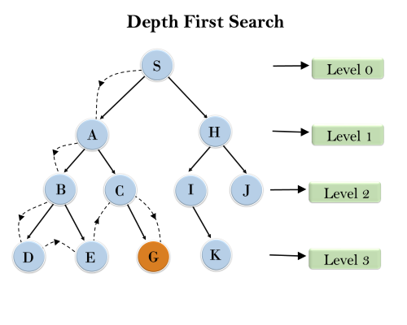
Depth-first Search
Depth-first search isa recursive algorithm for traversing a tree or graph data structure.
It is called the depth-first search because it starts from the root node and follows each path to its greatest depth node before moving to the next path.
DFS uses a stack data structure for its implementation.
The process of the DFS algorithm is similar to the BFS algorithm.
Example:
Root node--->Left node ----> right node.

Slide 19
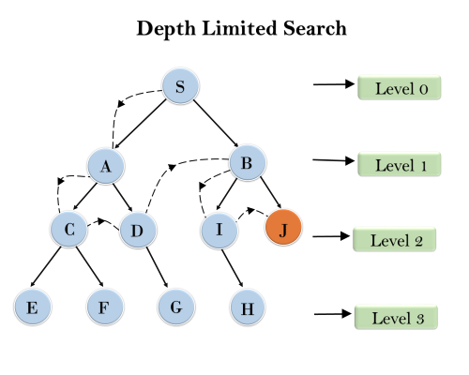
Depth-Limited Search Algorithm:
A depth-limited search algorithm is similar to depth-first search with a predetermined limit.
Depth-limited search can solve the drawback of the infinite path in the Depth-first search.
In this algorithm, the node at the depth limit will treat as it has no successor nodes further.
Depth-limited search can be terminated with two Conditions of failure:
Standard failure value: It indicates that problem does not have any solution.
Cutoff failure value: It defines no solution for the problem within a given depth limit.

Slide 20
Uniform-cost Search Algorithm:
Uniform-cost search is a searching algorithm used for traversing a weighted tree or graph.
This algorithm comes into play when a different cost is available for each edge.
The primary goal of the uniform-cost search is to find a path to the goal node which has the lowest cumulative cost.
Uniform-cost search expands nodes according to their path costs form the root node.
It can be used to solve any graph/tree where the optimal cost is in demand.
A uniform-cost search algorithm is implemented by the priority queue.
It gives maximum priority to the lowest cumulative cost.
Uniform cost search is equivalent to BFS algorithm if the path cost of all edges is the same.

Slide 21
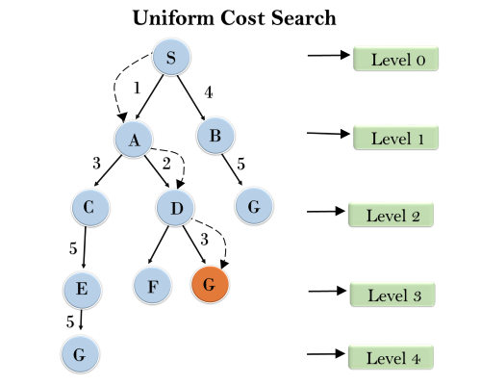

Slide 22
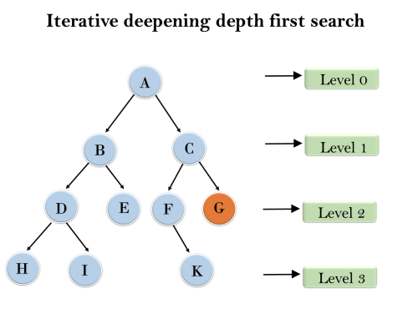
Iterative deepeningdepth-first Search:
The iterative deepening algorithm is a combination of DFS and BFS algorithms. This search algorithm finds out the best depth limit and does it by gradually increasing the limit until a goal is found.
This algorithm performs depth-first search up to a certain "depth limit", and it keeps increasing the depth limit after each iteration until the goal node is found.
This Search algorithm combines the benefits of Breadth-first search's fast search and depth-first search's memory efficiency.
The iterative search algorithm is useful uninformed search when search space is large, and depth of goal node is unknown.
1'st Iteration-----> A
2'nd Iteration----> A, B, C
3'rd Iteration------>A, B, D, E, C, F, G
4'th Iteration------>A, B, D, H, I, E, C, F, K, G
In the fourth iteration, the algorithm will find the goal node.

Slide 23
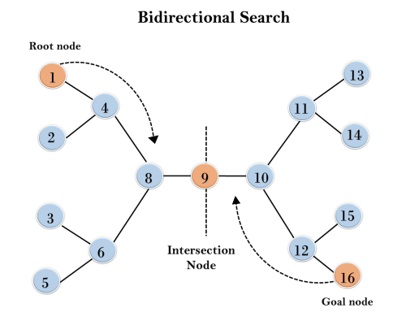
Bidirectional Search Algorithm:
Bidirectional search algorithm runs two simultaneous searches, one form initial state called as forward-search and other from goal node called as backward-search, to find the goal node.
Bidirectional search replaces one single search graph with two small subgraphs in which one starts the search from an initial vertex and other starts from goal vertex.
The search stops when these two graphs intersect each other.
Bidirectional search can use search techniques such as BFS, DFS, DLS, etc.

Slide 24
Informed Search Algorithms
So far we have talked about the uninformed search algorithms which looked through search space for all possible solutions of the problem without having any additional knowledge about search space.
But informed search algorithm contains an array of knowledge such as how far we are from the goal, path cost, how to reach to goal node, etc.
This knowledge help agents to explore less to the search space and find more efficiently the goal node.
The informed search algorithm is more useful for large search space. Informed search algorithm uses the idea of heuristic, so it is also called Heuristic search.

Slide 25
Heuristics function:
Heuristic is a function which is used in Informed Search, and it finds the most promising path.
It takes the current state of the agent as its input and produces the estimation of how close agent is from the goal.
The heuristic method, however, might not always give the best solution, but it guaranteed to find a good solution in reasonable time.
Heuristic function estimates how close a state is to the goal.
It is represented by h(n), and it calculates the cost of an optimal path between the pair of states.
The value of the heuristic function is always positive.
h(n) <= h*(n)
Here h(n) is heuristic cost, and h*(n) is the estimated cost. Hence heuristic cost should be less than or equal to the estimated cost.

Slide 26
Pure Heuristic Search:
Pure heuristic search is the simplest form of heuristic search algorithms.
It expands nodes based on their heuristic value h(n). It maintains two lists, OPEN and CLOSED list.
In the CLOSED list, it places those nodes which have already expanded and in the OPEN list, it places nodes which have yet not been expanded.
On each iteration, each node n with the lowest heuristic value is expanded and generates all its successors and n is placed to the closed list. The algorithm continues unit a goal state is found.
In the informed search we will discuss two main algorithms which are given below:
Best First Search Algorithm(Greedy search)
A* Search Algorithm

Slide 27
Best-first Search Algorithm (Greedy Search):
Greedy best-first search algorithm always selects the path which appears best at that moment.
It is the combination of depth-first search and breadth-first search algorithms.
It uses the heuristic function and search. Best-first search allows us to take the advantages of both algorithms.
With the help of best-first search, at each step, we can choose the most promising node.
In the best first search algorithm, we expand the node which is closest to the goal node and the closest cost is estimated by heuristic function, i.e.
f(n)= g(n).
Were, h(n)= estimated cost from node n to the goal.
The greedy best first algorithm is implemented by the priority queue.
Best first search algorithm:
Step 1: Place the starting node into the OPEN list.
Step 2: If the OPEN list is empty, Stop and return failure.
Step 3: Remove the node n, from the OPEN list which has the lowest value of h(n), and places it in the CLOSED list.

Slide 28
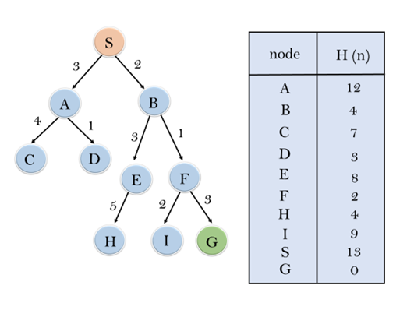
Step 4: Expand the node n, and generate the successors of node n.
Step 5: Check each successor of node n, and find whether any node is a goal node or not. If any successor node is goal node, then return success and terminate the search, else proceed to Step 6.
Step 6: For each successor node, algorithm checks for evaluation function f(n), and then check if the node has been in either OPEN or CLOSED list. If the node has not been in both list, then add it to the OPEN list.
Step 7: Return to Step 2.

Slide 29
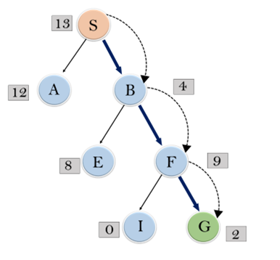
In this search example, we are using two lists which are OPEN and CLOSED Lists. Following are the iteration for traversing the above example.
Expand the nodes of S and put in the CLOSED list
Initialization: Open [A, B], Closed [S]
Iteration 1: Open [A], Closed [S, B]
Iteration 2: Open [E, F, A], Closed [S, B]
: Open [E, A], Closed [S, B, F]
Iteration 3: Open [I, G, E, A], Closed [S, B, F]
: Open [I, E, A], Closed [S, B, F, G]
Hence the final solution path will be: S----> B----->F---->

